Slide 1

Eliciting data from human participants
Janet Salmons, PhD

Slide 2
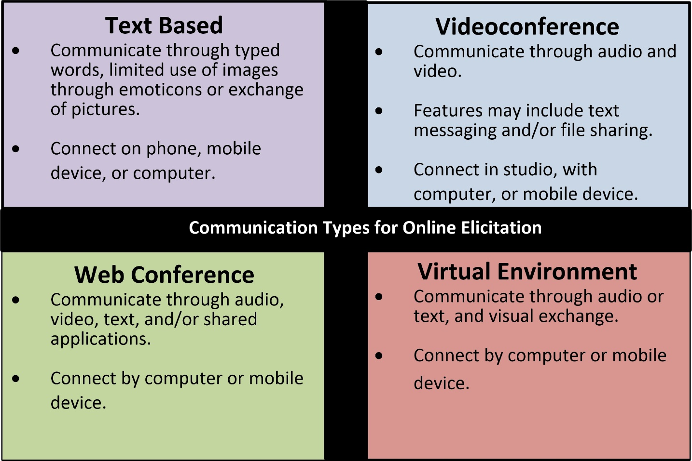
What Does It Mean to Elicit Data online?
Online elicitation in 1-1 or group interviews can occur through and with
a wide range of information and communications technologies(ICTs).

Slide 3
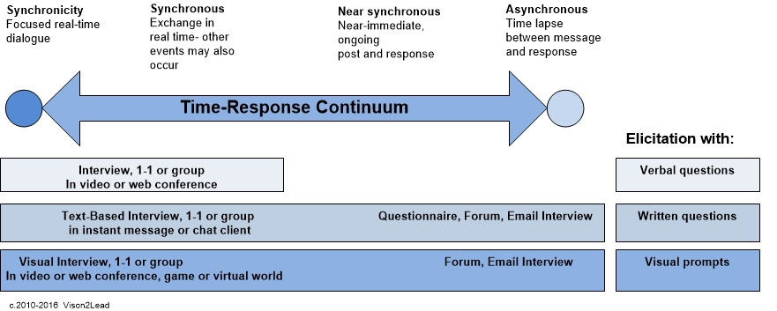
options for eliciting data

Slide 4
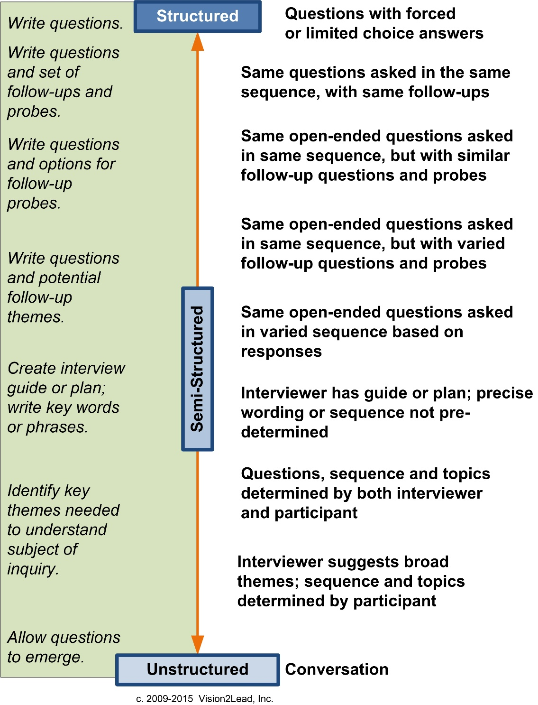
Collect data with Questions
Structured: All questions are articulated in advance.
Semi-structured: Main questions are articulated in advance, follow-up questions are determined during the interview when more details are needed.
Unstructured: Questions determined during the interview.
Typology of E-Interview Structures

